Slide 1

Facial Emotion Recognition (FER)
Using the FER13 dataset
Team Members
Shobha Ojha
Yash Tated
Shaista
Ritvik Rao
Yuvraj Thakur

Slide 2
Objectives
Real-Time Emotion Analysis: Analyze users' emotions on social media in real time
Content Personalization: Personalize social media content dynamically based on detected emotional states to enhance user engagement

Slide 3
Use Cases
Personalized Content: Recommend soothing or uplifting content tailored to users' emotional states (e.g., detect sadness and suggest uplifting videos or positive interactions).
User Engagement: Dynamically adapt social media feeds to match users' moods. It will help to Boost user satisfaction, retention, and interaction.
Emotional Support: Implement an emotionally aware interface for more intuitive and human-like interactions.
Privacy-Centric AI: Ensure ethical compliance by processing emotional data locally. Emphasize user data privacy and security.

Slide 4
Dataset Description
Dataset: FER-2013Plus is used for training and testing the model
Emotion Categories: Anger, Contempt, Disgust, Fear, Happiness, Neutral, Sadness, Surprise
FER-2013 Stats: 35,485 images, grayscale, 48x48 pixels
Split: Training (28,386), Test (7,099)
Challenges: Low resolution and overlapping features between some emotions
Source: Fer-2013Plus

Slide 5
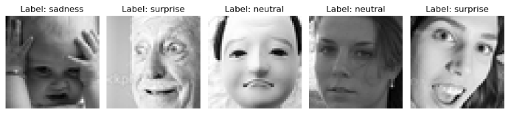
Sample Images​

Slide 6
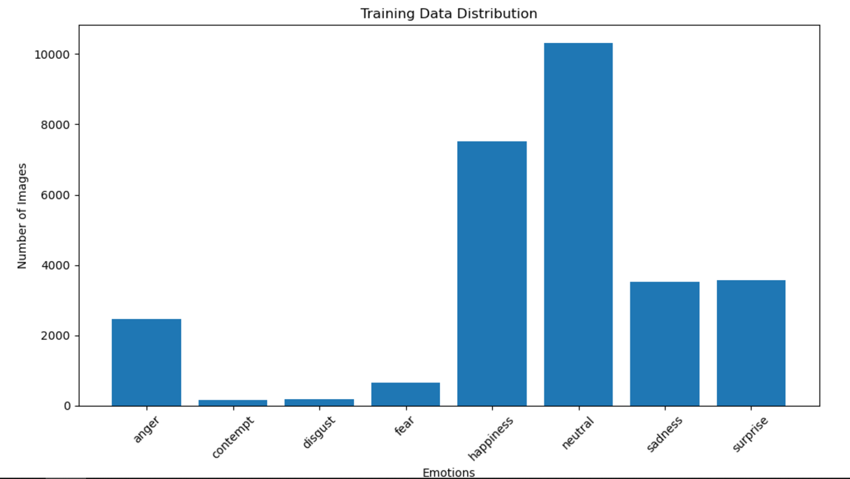
Training Data Distribution

Slide 7
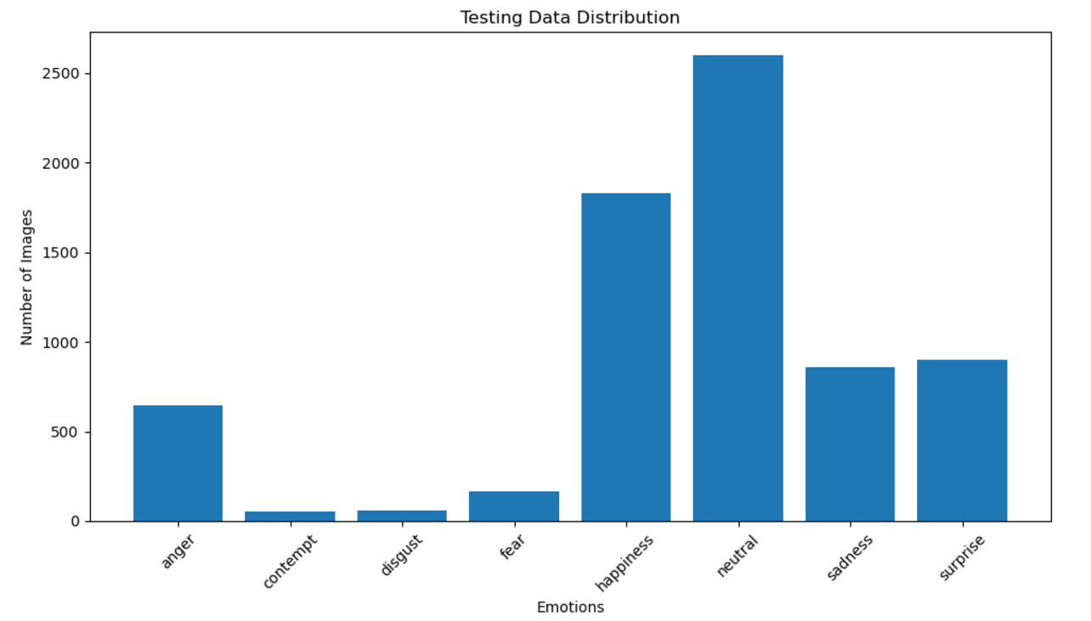
Testing Data Distribution​

Slide 8
Data Augmentation
To enhance the robustness and generalizability of the emotion detection model, data augmentation was applied to the training dataset.
Random Rotations: Applied random rotations within a specified range
Width and Height Shifts: Randomly shifted images horizontally and vertically
Zooming: Random zoom applied to either enlarge or reduce the visible portion of the image.
Horizontal Flipping: Flipped images horizontally.
Rescaling: Normalized pixel values to the range [0, 1].

Slide 9
Model Development
ResNet50
Real-time emotion recognition: ResNet's efficiency enables high accuracy in real-time tasks.
Avoids vanishing gradient: Skip connections ensure smooth gradient flow in deep networks.
Supports deep architectures: Allows deeper models without performance degradation.
Robust feature extraction: Excels at extracting complex patterns for accurate recognition.

Slide 10
Model Development​
CNN
Extracts spatial features: Captures edges, textures, and facial landmarks.
Layered architecture: Uses convolutional, pooling, and fully connected layers.
Emotion classification: Effectively classifies emotions from visual data.
Localized feature detection: Identifies patterns in specific image regions.

Slide 11
Model results​

Slide 12
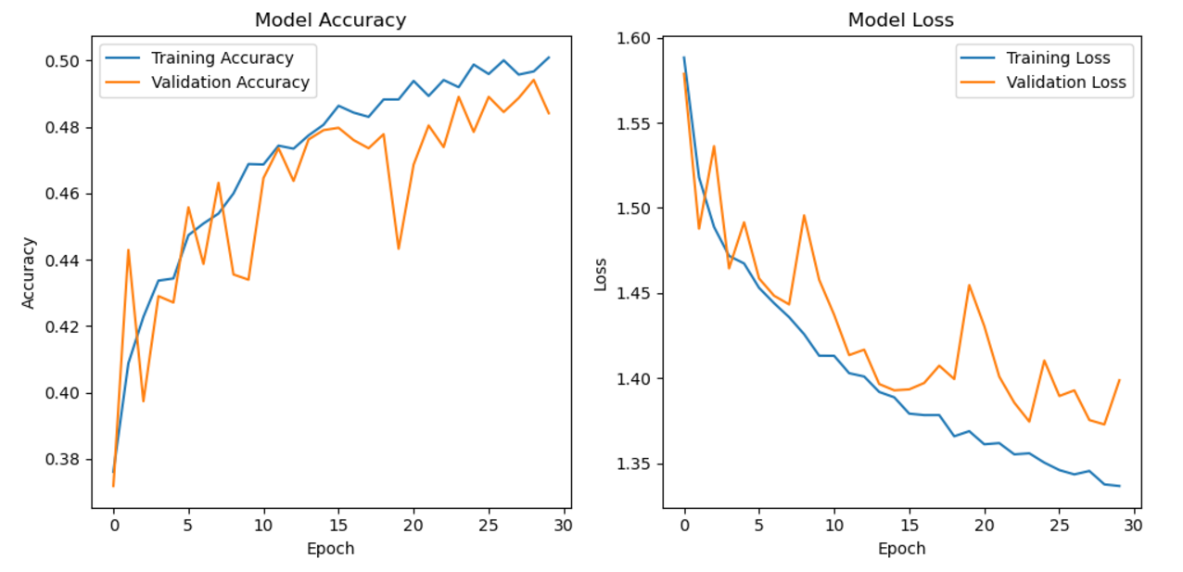
Resnet 50- Model Accuracy and Loss
Test accuracy: 0.4957 Test loss: 1.4054

Slide 13
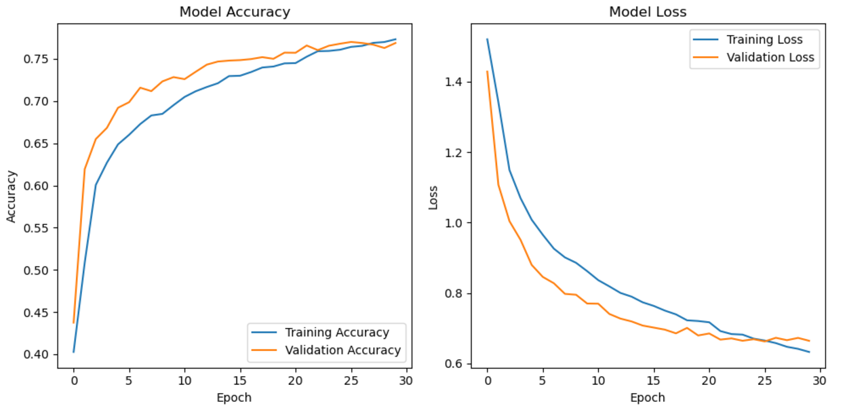
CNN-Model Accuracy and Loss
Test accuracy: 0.7688
Test loss: 0.6645

Slide 14
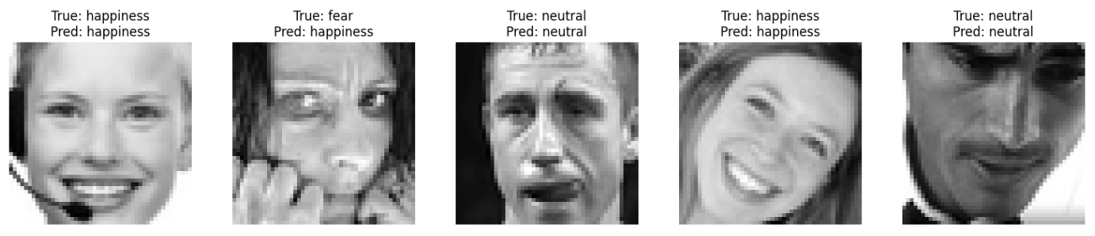
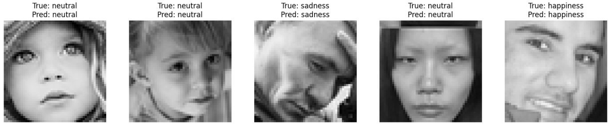
Model Predictions
ResNet50: ​
CNN: ​

Slide 15
Model Results Comparison
 | ResNet50 |  |  | CNN
 | Precision | Recall | F1-Score | Precision | Recall | F1-Score
Accuracy |  |  | 0.49 |  |  | 0.77
Macro Average | 0.40 | 0.25 | 0.23 | 0.79 | 0.52 | 0.56
Weighted Average | 0.48 | 0.49 | 0.43 | 0.77 | 0.77 | 0.75

Slide 16
ResNet Performance
ResNet50 is designed for high-resolution, RGB images, while the dataset used grayscale, low-resolution images
The complex architecture of ResNet50 may have overfitted the limited data, reducing generalization
Pre-trained ResNet50 weights might not align well with features specific to emotion detection
ResNet50's deeper layers may have introduced unnecessary complexity for a relatively simple grayscale dataset
Since, the dataset has imbalanced classes , ResNet struggled more to balance predictions across classes

Slide 17
Conclusion
CNN outperformed ResNet50 in all metrics (Accuracy: 77% vs. 49%)
CNN demonstrated superior precision (79%) and recall (52%) compared to ResNet50
Custom CNN is better tailored for grayscale, low-resolution emotion datasets than ResNet50
Model architecture plays a critical role; custom CNNs may outperform pre-trained models for specialized tasks

